Slide 1
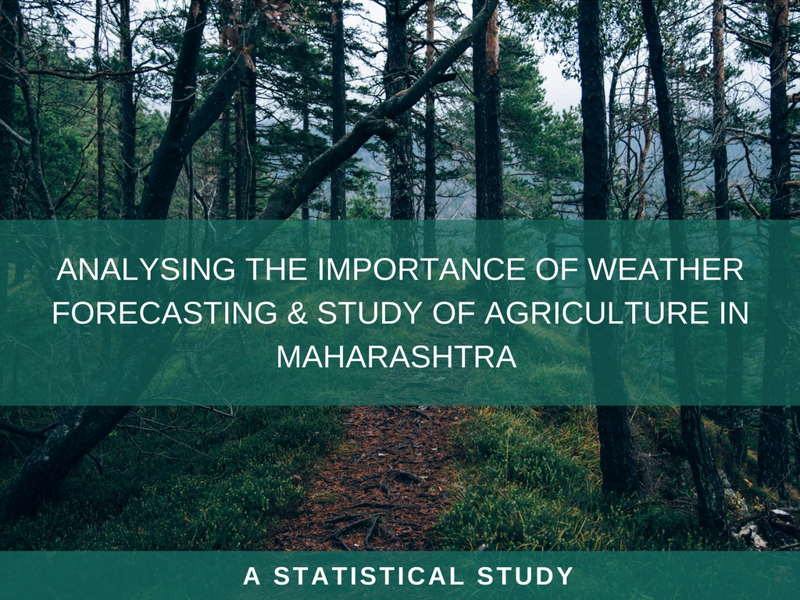
analysing the importance of weather forecasting & study of agriculture in maharashtra
A STATISTICAL STUDY
Mr. Soham Manish Wani. Research Scholar, Dept. of Statistics, K. C. College, Mumbai University, Mumbai.
Ms. Shailaja Rane. (Mentor) Professor, Dept. of Statistics, K. C. College, Mumbai University, Mumbai.

Slide 2
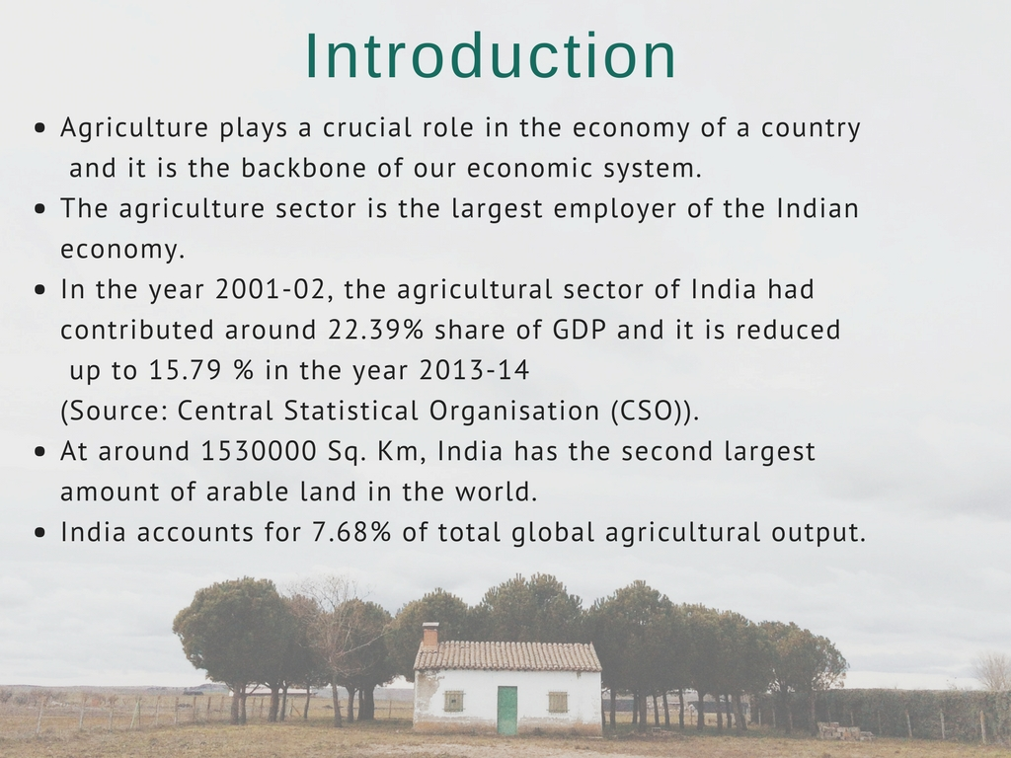
Introduction
Agriculture plays a crucial role in the economy of a country and it is the backbone of our economic system.
The agriculture sector is the largest employer of the Indian economy.
In the year 2001-02, the agricultural sector of India had contributed around 22.39 per cent share of GDP and it is reduced up to 15.79 % in the year 2013-14 (Source : Central Statistical Organisation (CSO)).
At around 1530000 Sq. Km, India has the second largest amount of arable land in the world.
India accounts for 7.68% of total global agricultural output.

Slide 3
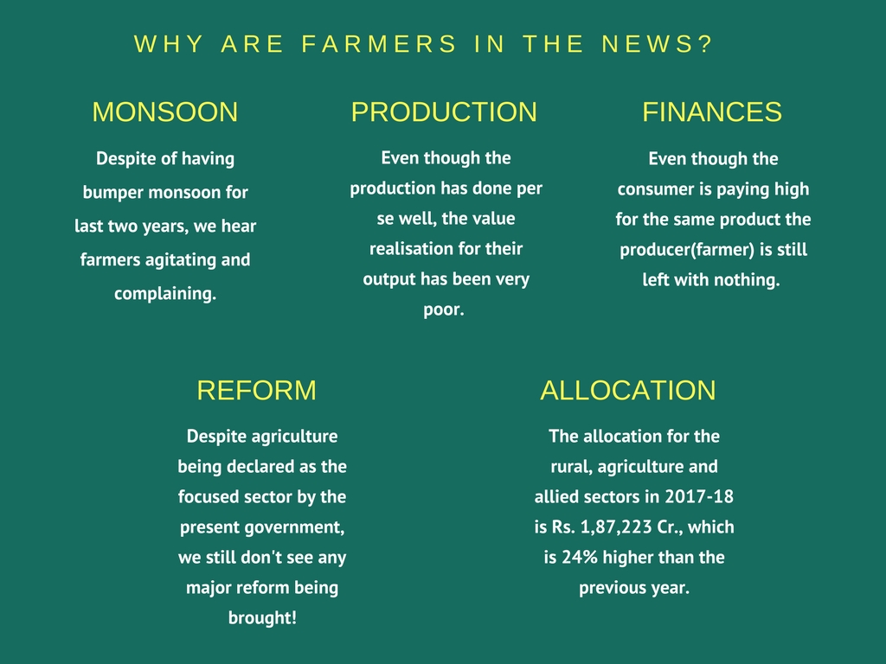
Why farmers are in news?
Despite of having bumper monsoon for last two years, we hear farmers agitating and complaining.
Even though the production has done per se well, the value realisation for their output has been very poor.
Even though the consumer is paying high for the same product the producer(farmer) is still left with nothing. Why?
Despite agriculture being declared as the focused sector by the present government, we still don't see any major reform being brought!
The total allocation for the rural, agriculture and allied sectors in 2017-18 is Rs. 1,87,223 Cr., which is 24% higher than the previous year. Then what is going wrong?

Slide 4

THE FARMERS RIDDLE

Slide 5
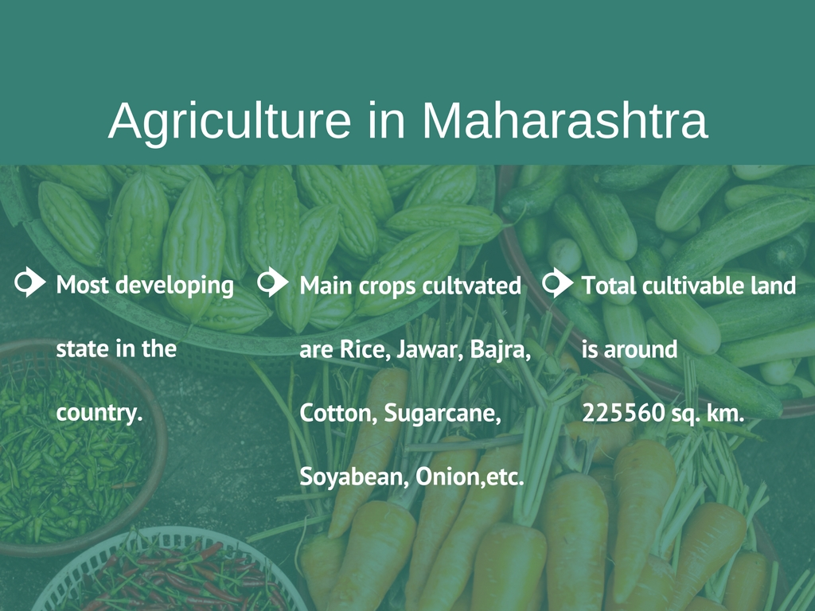
Agriculture in Maharashtra
Most developing state in the country.
Total cultivable land is around 225560 sq. km.
Main crops cultvated - Rice, Jawar, Bajra, Cotton, Sugarcane, Soyabean, Onion,etc.

Slide 6
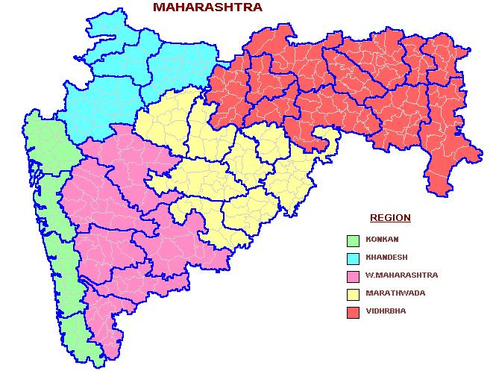
KHANDESH
VIDARBHA
MARATHWADA
KONKAN
WESTERN MAHARASHTRA

Slide 7
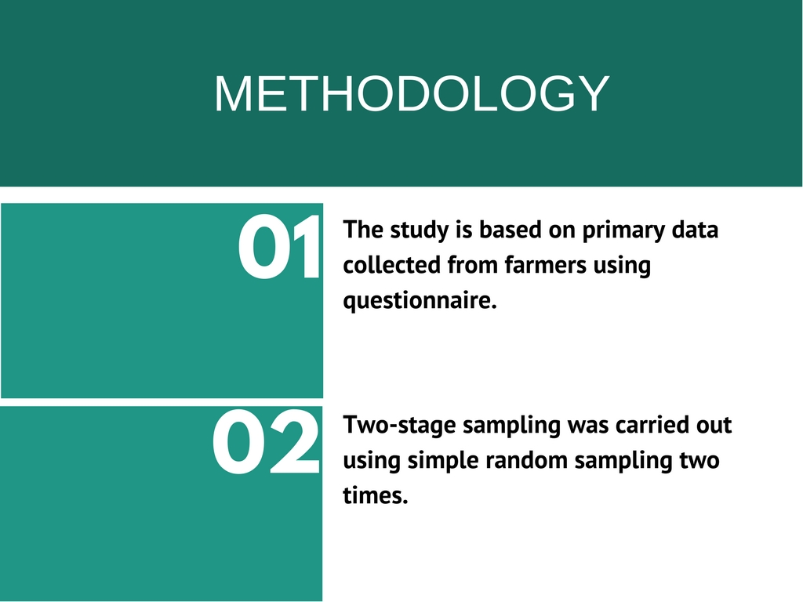

Slide 8
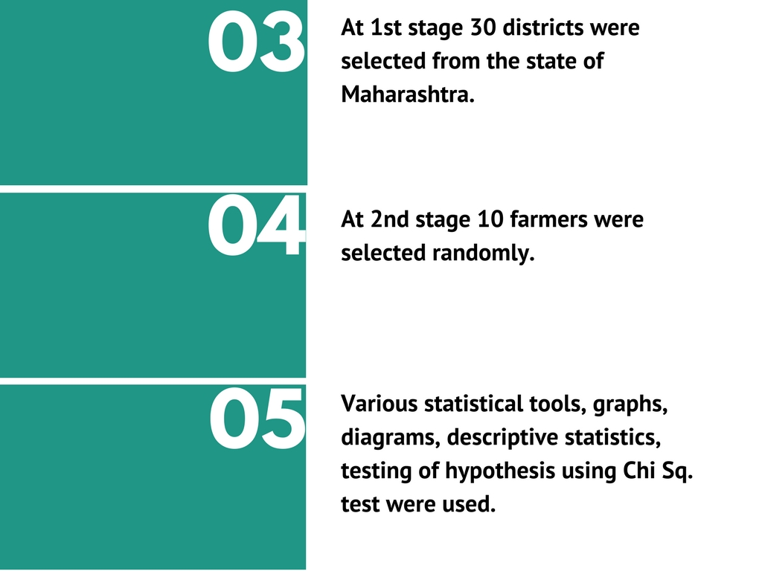

Slide 9
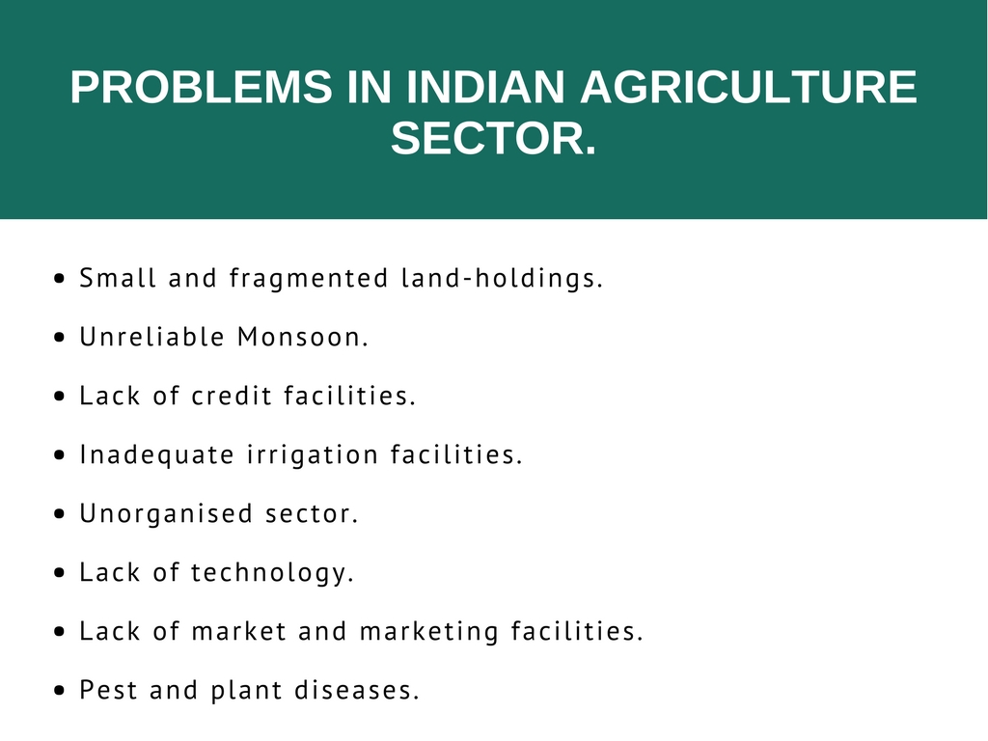

Slide 10
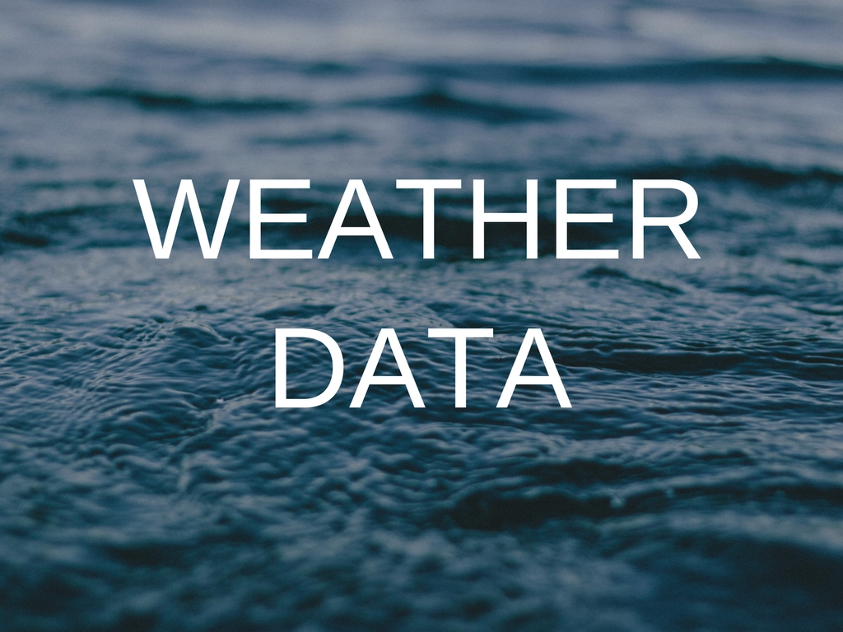

Slide 11
Sources Of Weather Data
No. of farmers
SOURCE

Slide 12
Use of Weather Data District Wise
No. of farmers
DISTRICTS
Notes:
Conclude about jalna

Slide 13
Is the business profitable during the whole year?
No. of farmers
DISTRICTS

Slide 14
Statistics
Ho: There is no association between the using weather data and earning profits.
H1: Not Ho.
χ²cal = 7.186
Χ²tab = 3.85
P-value=0.007
Result: Since p-value is very small the null hypothesis will be rejected.
Conclusion: There is association between using weather data and earning profits.

Slide 15
Applied for Loans
No. of farmers
DISTRICTS

Slide 16
Defaulters
No. of farmers
DISTRICTS

Slide 17
Applied for Loan Waiver
No. of farmers
DISTRICTS

Slide 18
How much compensation did you received.
No. of farmers
DISTRICTS

Slide 19
P1: Proportion of farmers who got waiver and are eligible for loan waiver P2: Proportion of farmers who got waiver but are not eligible for loan waiver Ho: P1=P2 Vs. H1: P1>P2 Zcal= 0.52311 Ztab= 1.645 P- Value = 0.2988 Result: Since p-value is high we do not reject null hypothesis Conclusion: We can see that the government bodies don’t have a proper look on the background of farmers before dispensing compensation to them. There is no enough evidence to prove that the proportion of eligible farmers getting waiver is more than the proportion of ineligible framer getting waiver.
Applied for loan waiver
(170)
Eligible
(48)
Not Eligible
(122)
Got Waiver
(19)
Didn’t got waiver
(29)
Got Waiver
(43)
Didn’t got waiver
(79)

Slide 20
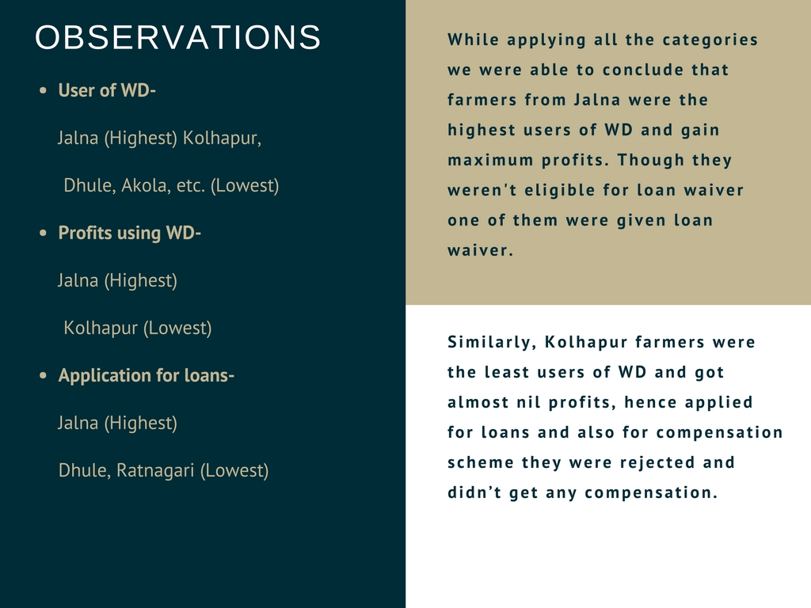

Slide 21
Age Vs. Use of Weather Data
No. of farmers
Age Group

Slide 22
Statistics
Ho: There is no association between age and use of weather data.
H1: Not Ho.
χ²statistic = 9.7340
P-value = 0.02097
Result: Since p-value is very small the null hypothesis is rejected.
Conclusion: There is association between use of weather data and age factor.

Slide 23
Education Vs. Use of Weather Data
USE OF WEATHER DATA
No. of farmers
EDUCATION

Slide 24
Statistics
Ho: There is no association between education and use of weather data.
H1: Not Ho.
χ²cal = 41.9034
P-value= 0.000000171
Result: Since p-value is very small the null hypothesis is rejected.
Conclusion: There is association between education and use of weather data.

Slide 25
Use of Weather Data Vs. Crop rain dependency
No. of farmers
Is your crop rain dependent?

Slide 26
STATISTICS
P: Proportion of farmers using weather data for rain affected crops
Ho: P=0.5 Vs. H1: P<0.5
P=0.38 q=0.63
Zcal = -3.5
Ztab = -1.645
P-value= 0.0002
Result: Since p-value is very small we reject null hypothesis.
Conclusion: The proportion of farmers using weather data is only 38%. We can say that weather data is not perfectly used.

Slide 27
At what stages can you make agricultural decisions based on weather data?
No. of farmers
STAGES

Slide 28
Major complaints made by farmers.
PERCENTAGE
COMPLAINTS

Slide 29
Sources of Irrigation during draught
PERCENTAGE
SOURCES

Slide 30
Crop Insurance
No. of farmers
DISTRICT
Notes:
Refer

Slide 31
Cost of insurance
Percentage
COST

Slide 32
Satisfaction Index
Satisfaction Index = -0.63
PERCENTAGE
OPINION

Slide 33
Development of agriculture in last 5 years
Satisfaction Index = -0.42
PERCENTAGE
OPINION

Slide 34
ANOVA
Ho1: There is no significant difference between the income generated by using weather data, experience and irrigation facility.
H11: There is significant difference.
H02: There is no significant difference between the income generated by the three chosen crops.
H12: There is significant difference.
As the p-value for rows is very high we conclude that there is significant difference being created due to having proper irrigation facility, experience and use of weather data.
Similarly we can say that there is no difference between the income generated from different crops.
ANOVA
Source of Variation | SS | df | MS | F | P-value | F crit
Rows | 16955320 | 2 | 8477660 | 0.684075 | 0.555227 | 6.944272
Columns | 5.14E+08 | 2 | 2.57E+08 | 20.72903 | 0.007743 | 6.944272
Error | 49571513 | 4 | 12392878
Total | 5.8E+08 | 8

Slide 35
Conclusion
&
Suggestions

Slide 36
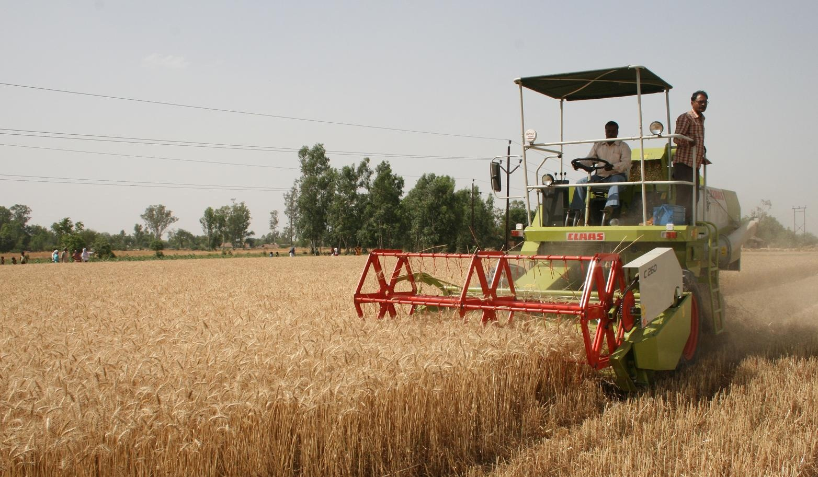
Thank you

